Slide 1
Pneumonia Immunization Awareness among older adults and determining the influence of Education in periodic vaccination
Iswarya vardhini Vigneshwar
Middle Georgia state university

Slide 2
Personal health behaviors and day to day activities of every individual will provide an impact on their life.
The Behavioral Risk Factor Surveillance System (BRFSS) is a telephone survey initiated by the CDC and conducted monthly by state health departments all over the USA.
This study will mine BRFSS dataset which consists of risk behaviors, health practices of U.S residents and tries to find the relationship of the demographic factor on the older individual’s pneumonia vaccination awareness.

Slide 3
Pneumonia is one of the primary diseases which may lead to mortality in older adults. It is one of the critical problems all over the world.
All over the world, many country’s governments are trying to create awareness on pneumonia. Pneumococcal vaccines are readily available, but those who benefit are not aware of that, and the vaccination rate is still low.
There are several studies which investigated to determine the reason why pneumonia vaccination uptake is low.

Slide 4
The Behavioral Risk Factor Surveillance System was established by the Centers for Disease Control and Prevention (CDC).
The data collected from the survey sample is the Behavioral Risk Factor Surveillance System (BRFSS) dataset.
The total sample participants from 2013 to 2017 with valid details are 7,20,525.

Slide 5

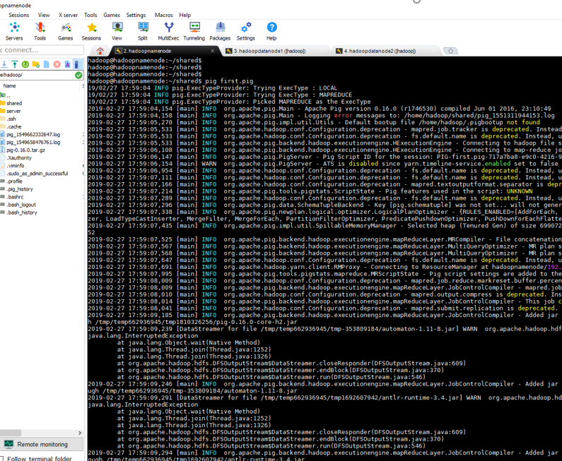
The researcher used Apache Hadoop 2.73 and stored this big dataset in HDFS. In order to retrieve the required variables for this research, Map Reduce code generated using Apache Pig is used.

Slide 6
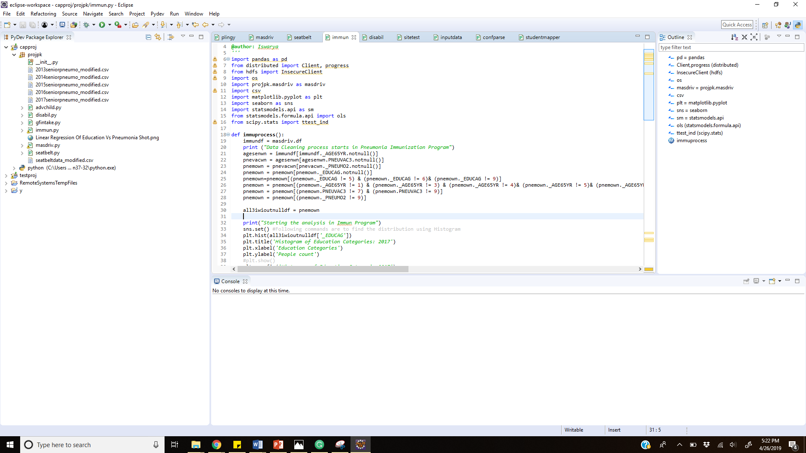
The obtained dataset contains not sure, missing and blank values in all the necessary columns and those details will be cleaned using Python Pandas.

Slide 7
Result
There is a gradual decrease in all the levels of the population who are not taking pneumonia vaccination.
Table 1 Descriptive Statistics of the Sample Independent Variables
Variable | Score | 2013 | 2014 | 2015 | 2016 | 2017
Education | Did not graduate high school | 15282 | 14108 | 11973 | 13403 | 10493
 | Graduated High school | 47417 | 46466 | 40896 | 47677 | 40130
 | Attended college or technical school | 36314 | 37614 | 35233 | 42305 | 38059
 | Graduated college | 43410 | 47035 | 45911 | 54944 | 51855
Older adults Pneumonia Vaccination | Yes | 98895 | 102275 | 98392 | 116831 | 107036
 | No | 43528 | 42948 | 35621 | 41498 | 33501

Slide 8
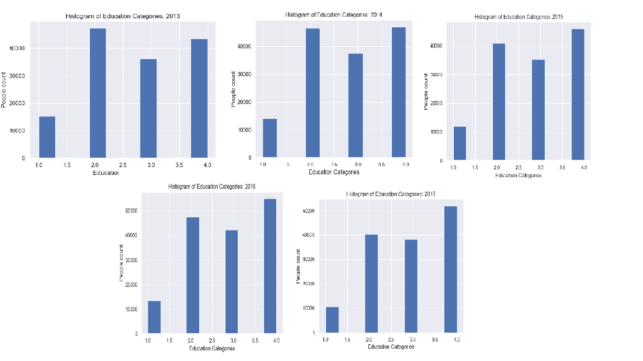
From overall data, it is observed that the population in education level who did not graduate from school is very less when compared to all other levels and the population of individuals who graduate from college is high.

Slide 9
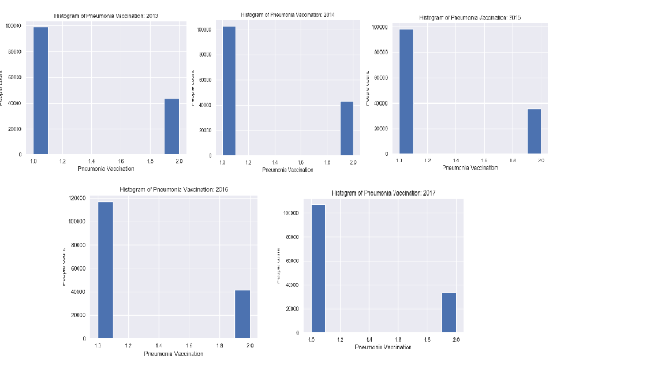
For all five years there is a huge difference observed in the population who take pneumonia vaccination and who didn’t take the pneumonia vaccination.

Slide 10
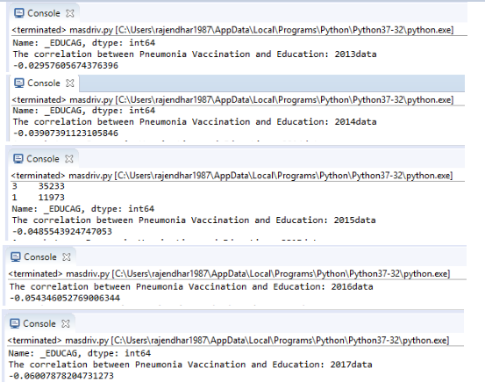
The Pearson correlation analysis between Education and Pneumonia Vaccination for the year 2013 to 2017 showed a very weak linear relationship between Education and Pneumonia Vaccination.

Slide 11
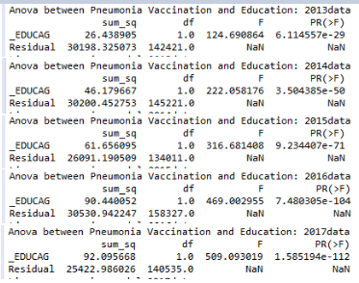
The one-way ANOVA between Education and Pneumonia Vaccination for the year 2013 to 2017 showed a statistically significant relationship found between Education and Pneumonia vaccination.

Slide 12
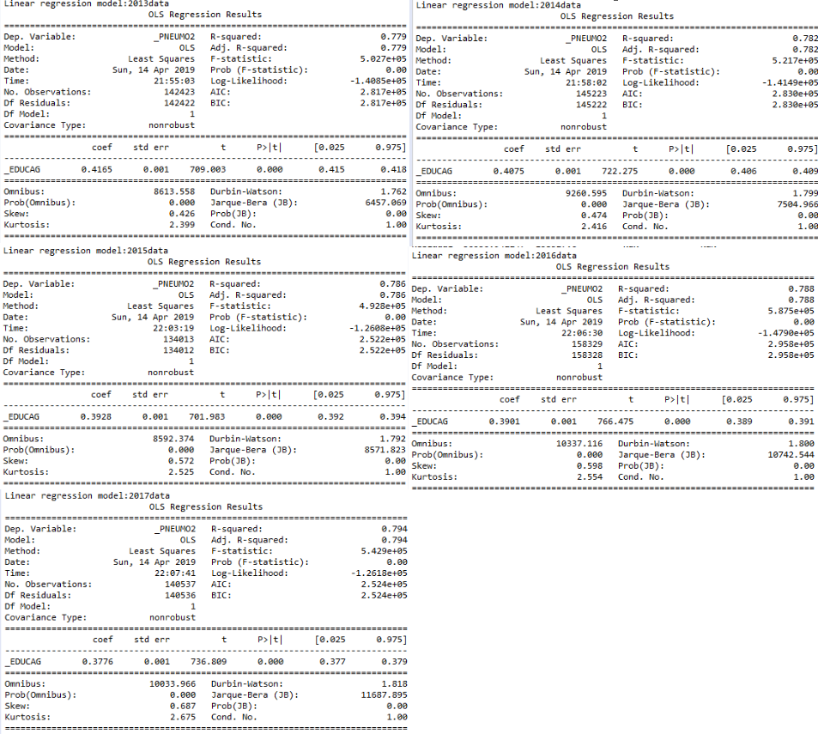
The result of linear regression analysis using Ordinary Least square model indicates that Education positively predicts Pneumonia vaccination for the year 2013 to 2017.

Slide 13
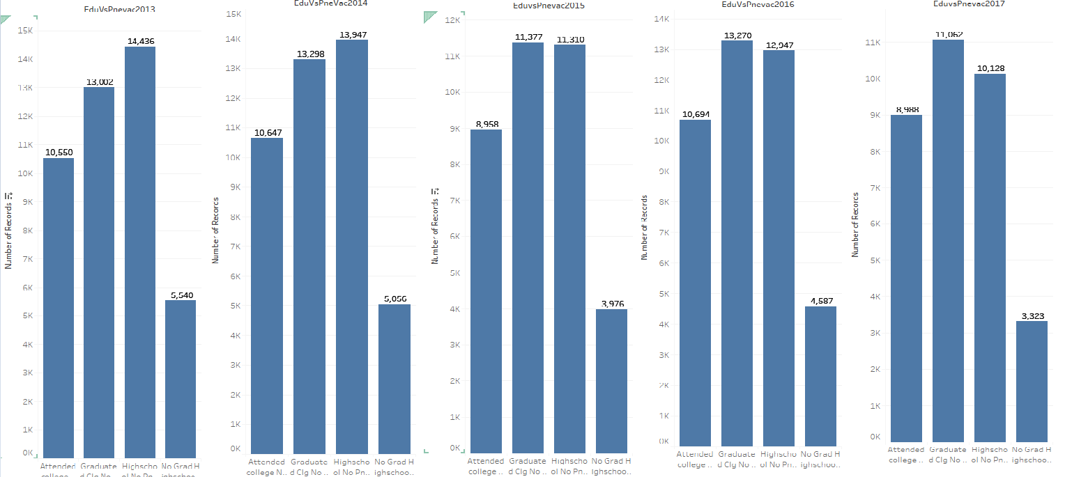
Tableau is used to compare the education level with the older adults who have not taken pneumonia vaccination for that year.
The graph shows that there is a gradual decrease in the number of individuals who are not taking pneumonia vaccination.

Slide 14
Conclusion
Though there are several campaigns happening to provide awareness about pneumonia and vaccination, the rate of individuals affected by pneumonia continues to be high.
Observing and analyzing the BRFSS dataset shows that there is a gradual increase in the uptake of pneumonia vaccination every year.
This study found a statically significant relationship between education and pneumonia vaccination uptake in older adults.

